Slide 1
America’s Fully Developed Suburbs
The First Suburbs

Slide 2
Social and economic conditions in America’s fully developed suburbs put many of these areas are at the cutting edge of economic, social and political change in American metropolitan areas.

Slide 3
Many first suburbs must deal with increasing poverty, deteriorating infrastructure, stressed schools with inadequate tax bases.

Slide 4
Examples:

Slide 5
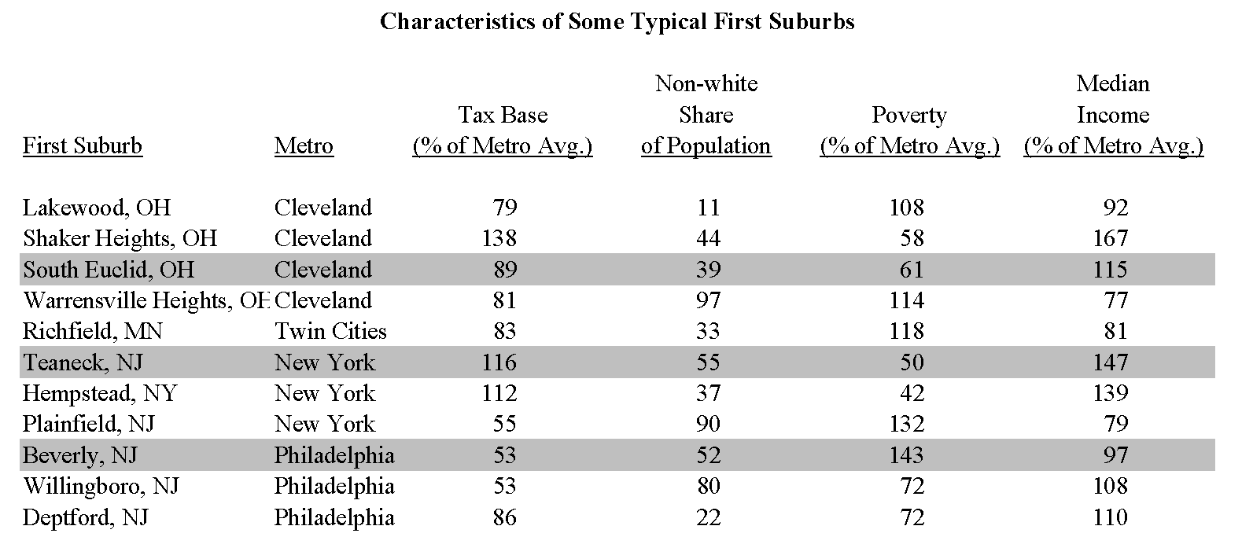

Slide 6
At the same time, they reflect the new America (and where America needs to go). They are walkable, transit-friendly, densely developed and diverse (racially, economically, politically).

Slide 7
Stabilizing these communities is crucial if we are to deal with sprawl, segregation and inequality.

Slide 8
It is also crucial for repairing our economy. Continuing sprawl, segregation and inequality wastes resources in First Suburbs—areas representing more than a third of the population in the 50 largest metropolitan areas.

Slide 9
Sprawl Distribution of Population in the 50 Largest Metropolitan areas (2005-09) Central Cities: 31% Fully Developed Suburbs: 34% Developing Suburbs: 25% Exurbs: 10% Fully Developed: % of land urbanized > 70% in 2000 Developing: % of land urbanized < 70% and > 10% Exurbs: % of land urbanized < 10%
65%

Slide 10
Fragmentation hurts fully developed areas by contributing to sprawl and fiscal inequality.

Slide 11
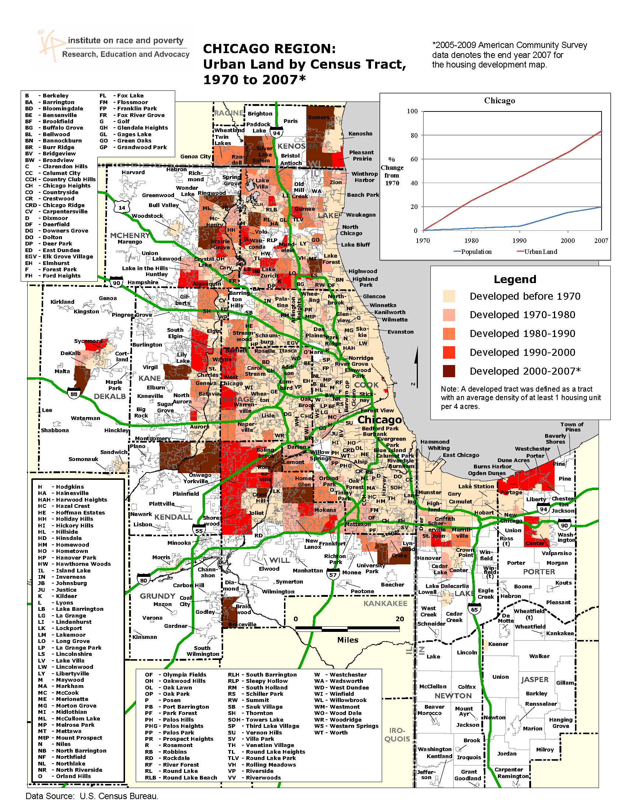

Slide 12
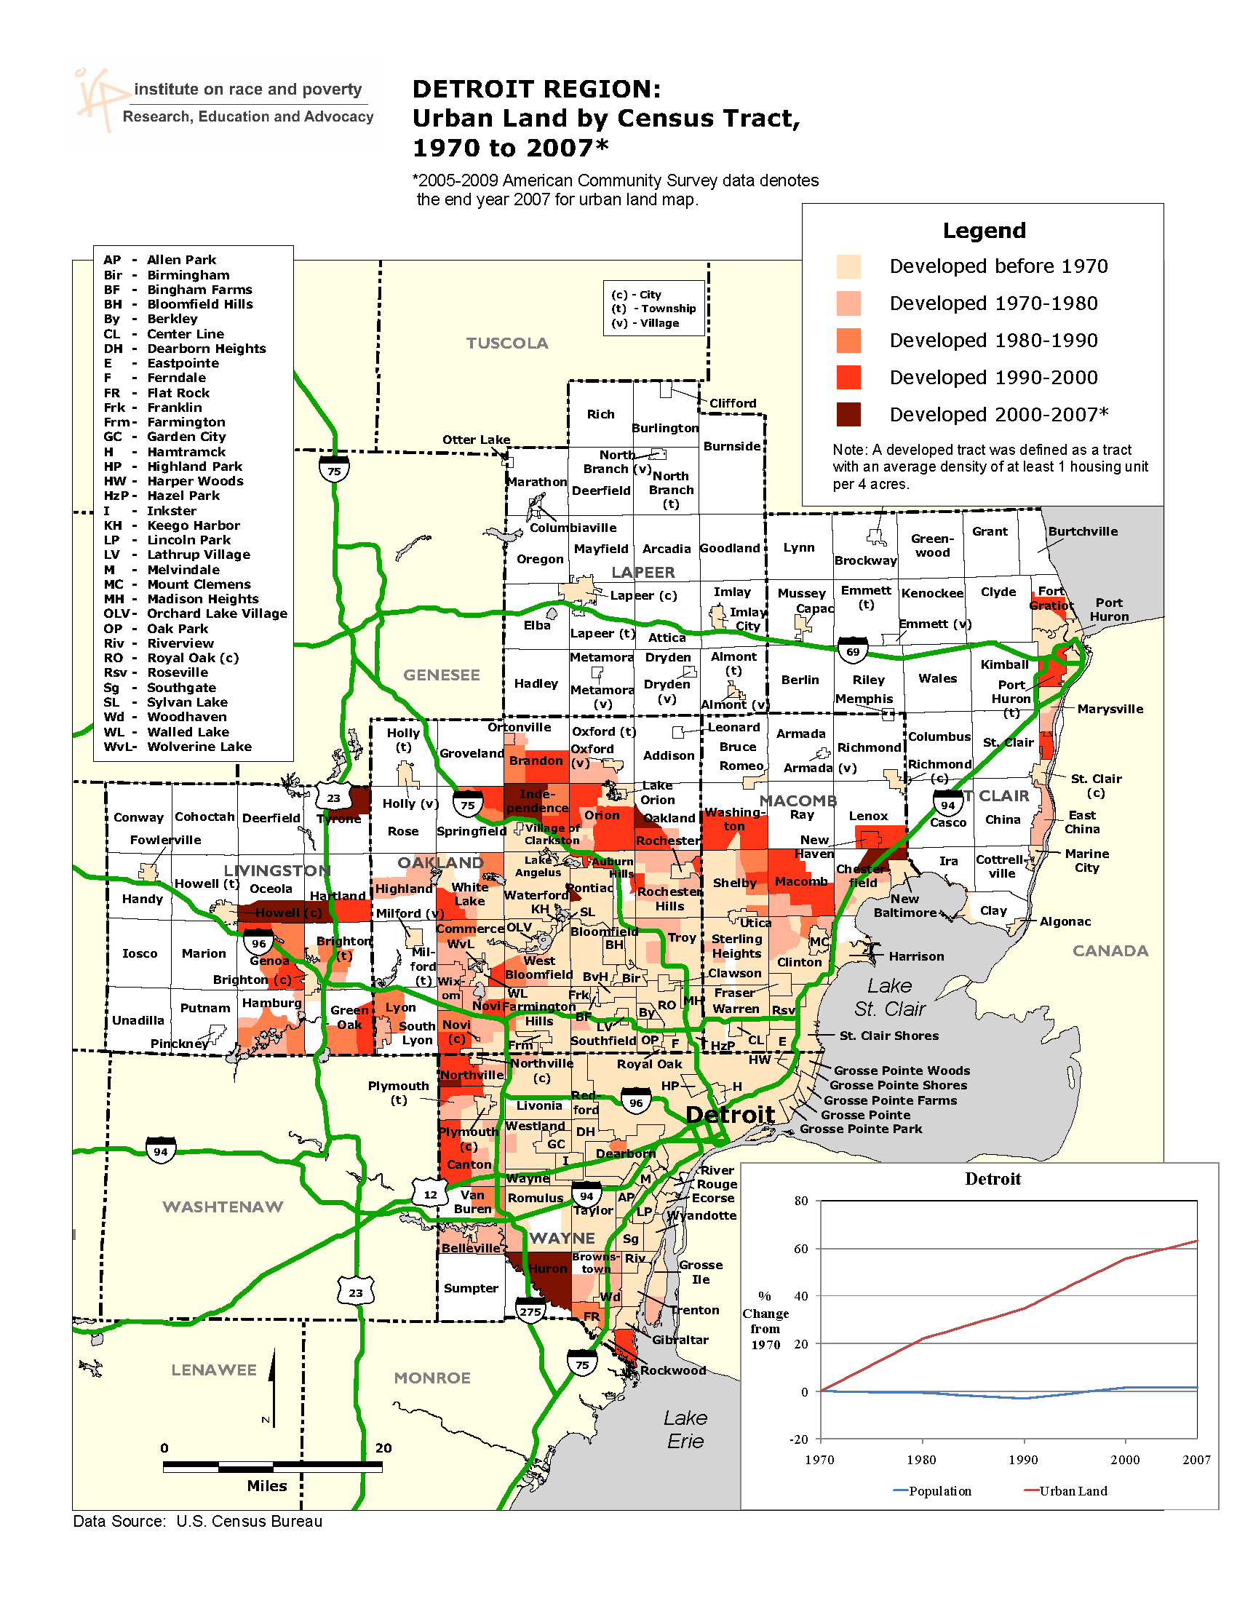

Slide 13
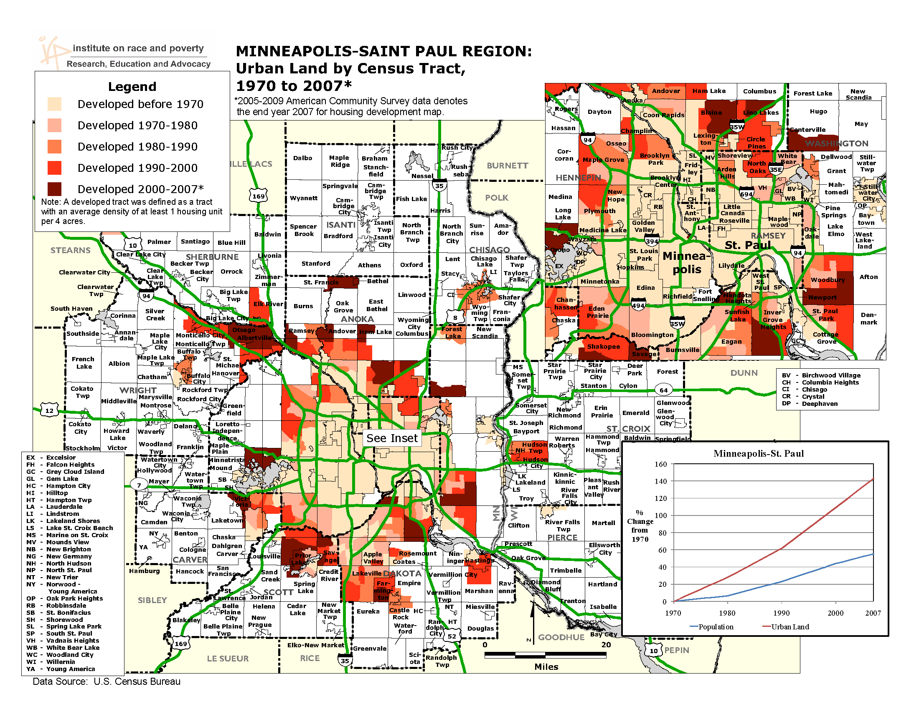

Slide 14
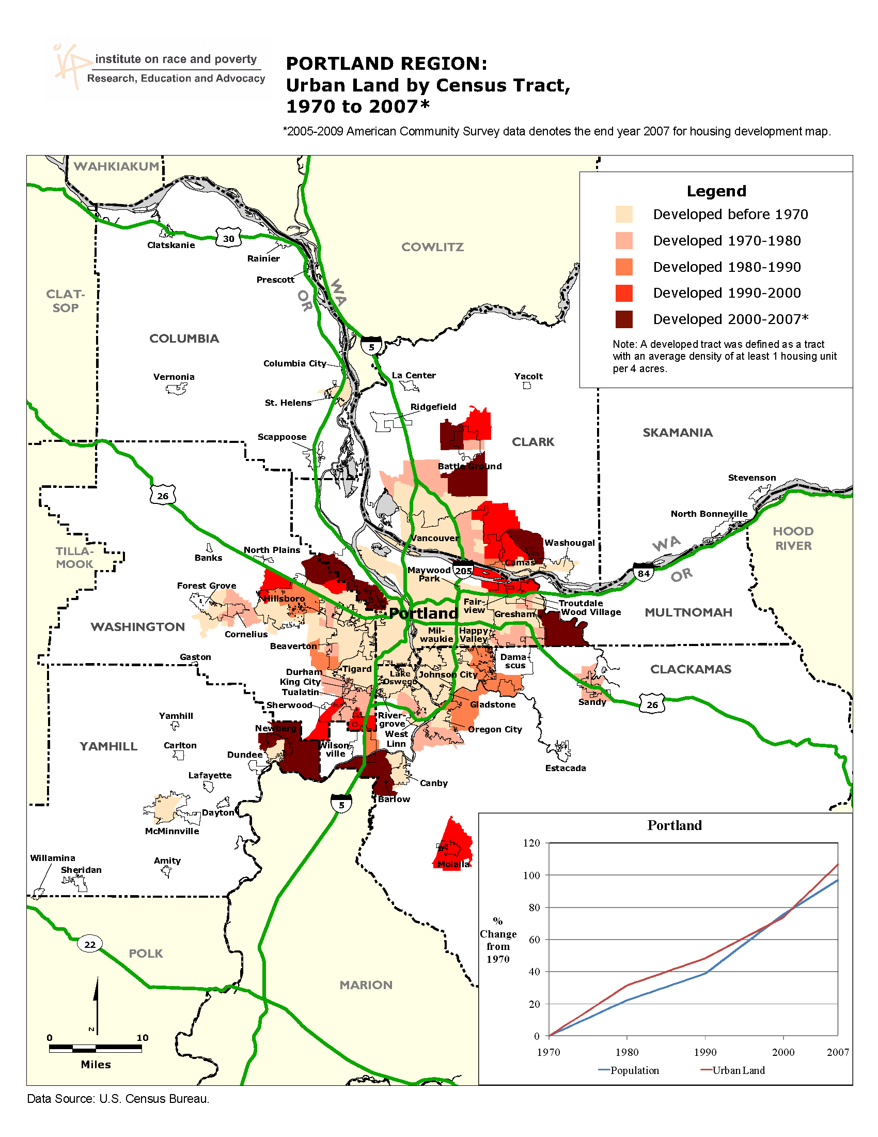

Slide 15
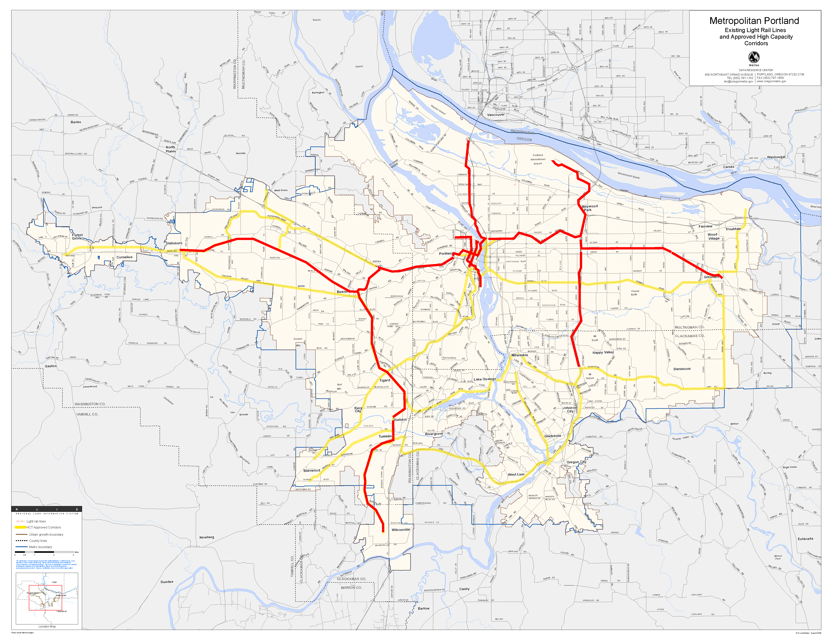
Coordinating Transportation and Housing Policy in Portland

Slide 17
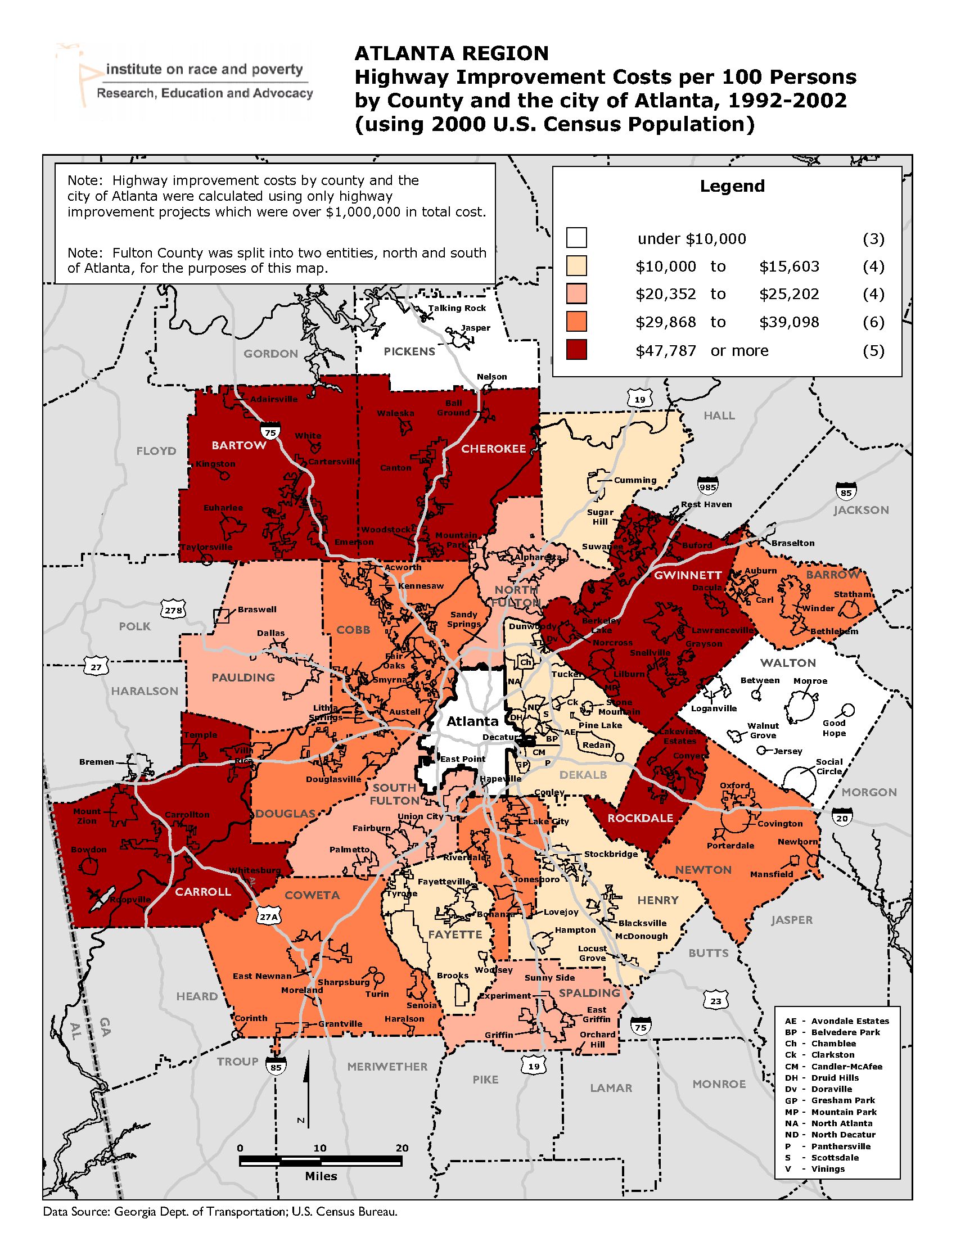
Sprawl-inducing Transportation Policy – Atlanta in the 1990s

Slide 18
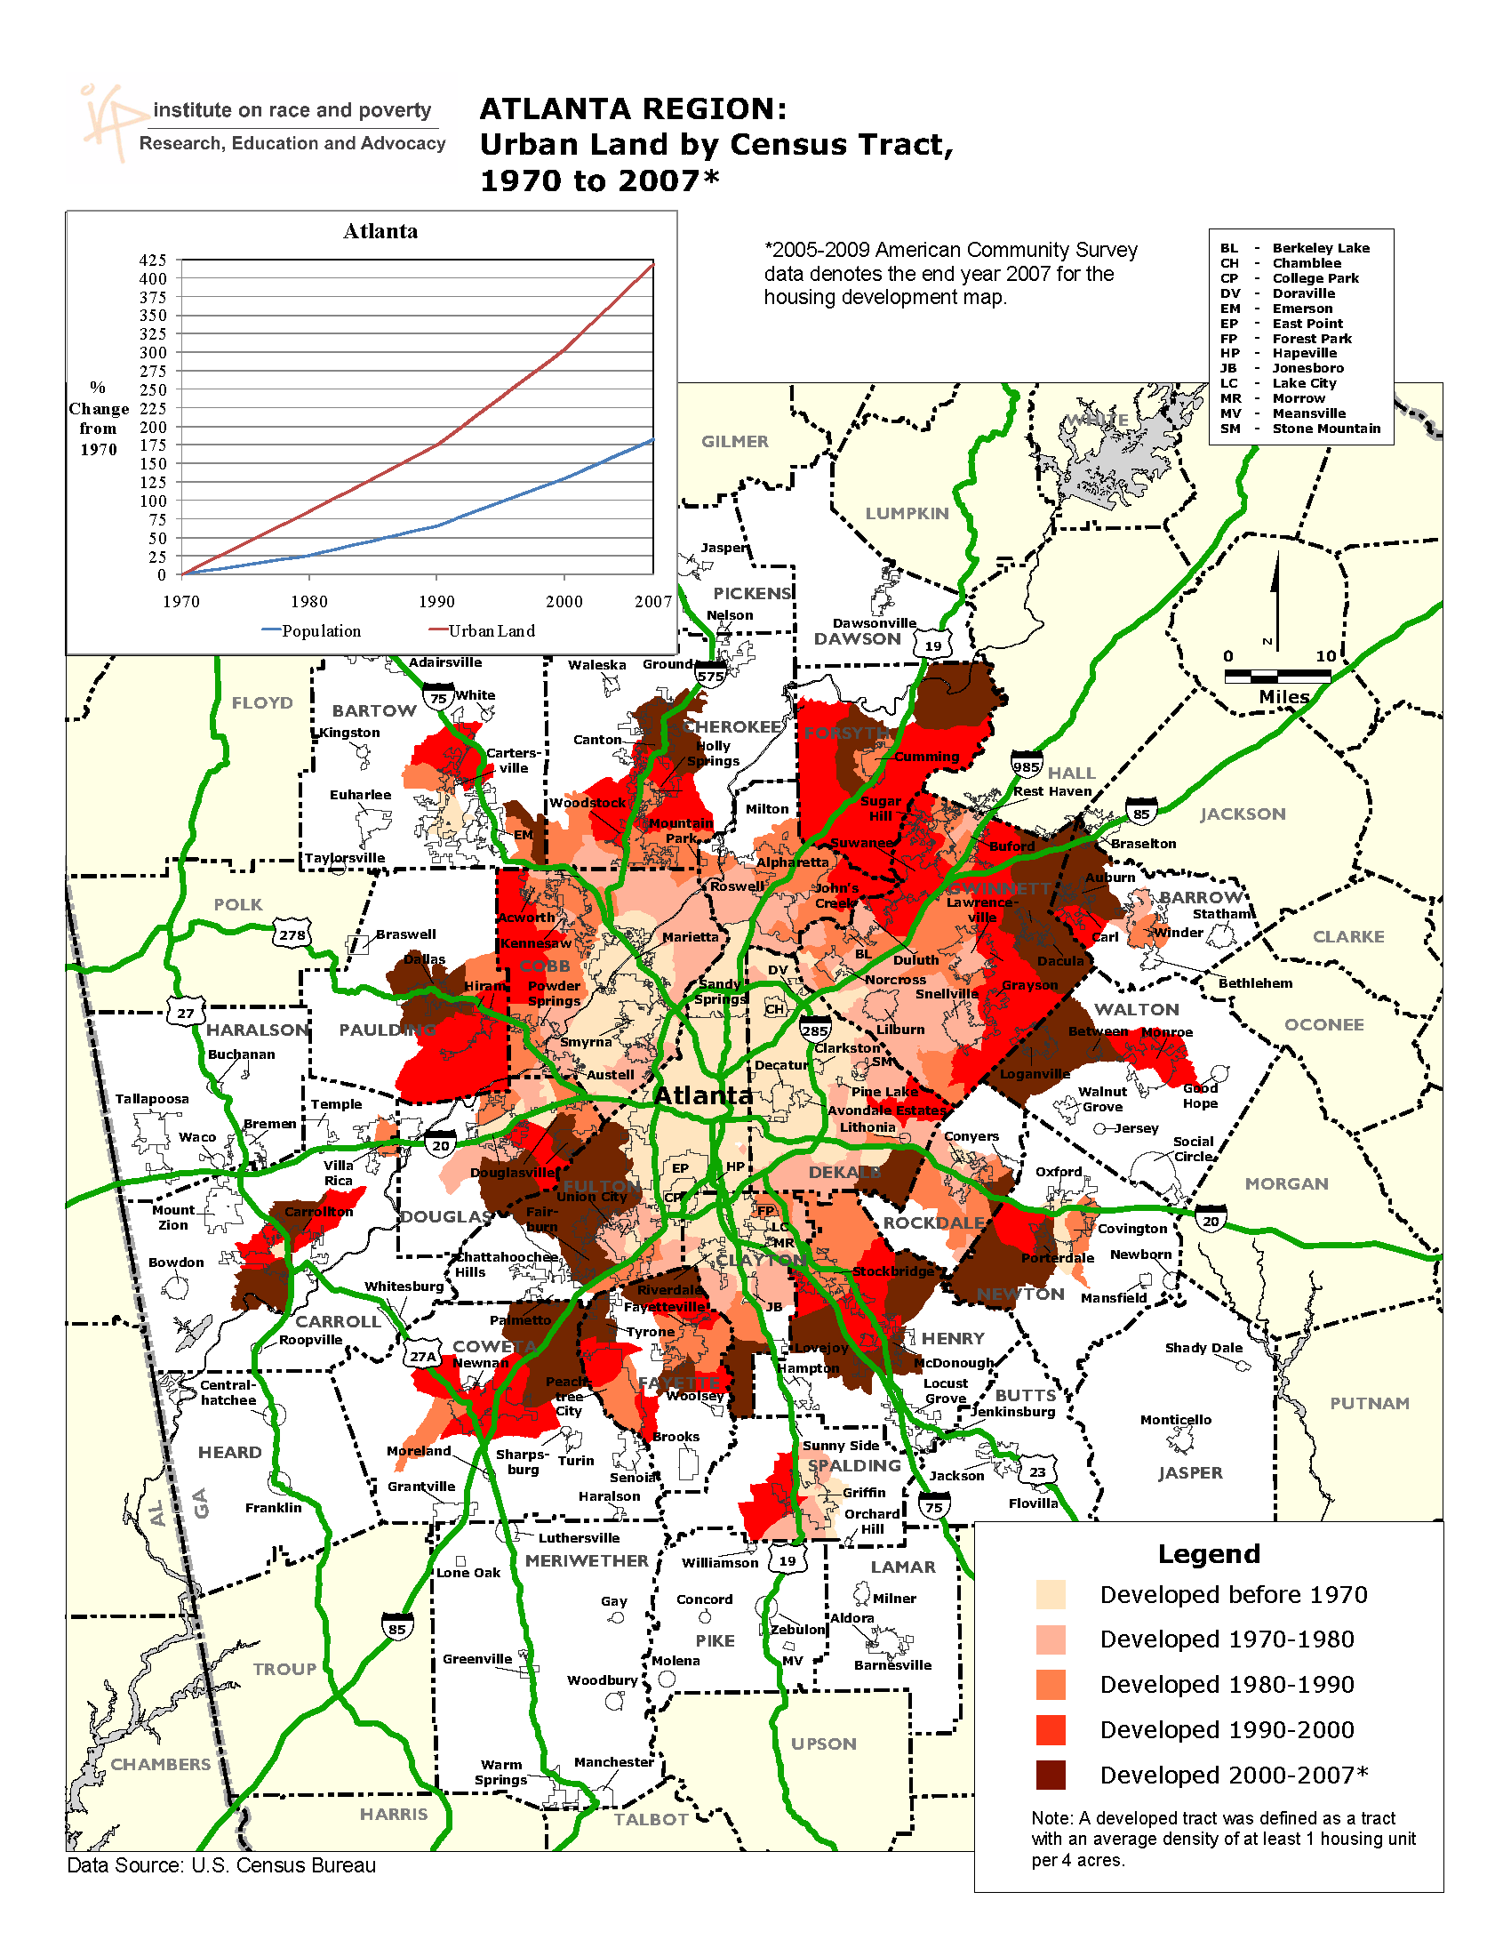

Slide 19
Tax Base 61% of the population in the 50 largest metropolitan areas lived in areas with tax bases less than the average for their metropolitan area in 2008

Slide 20
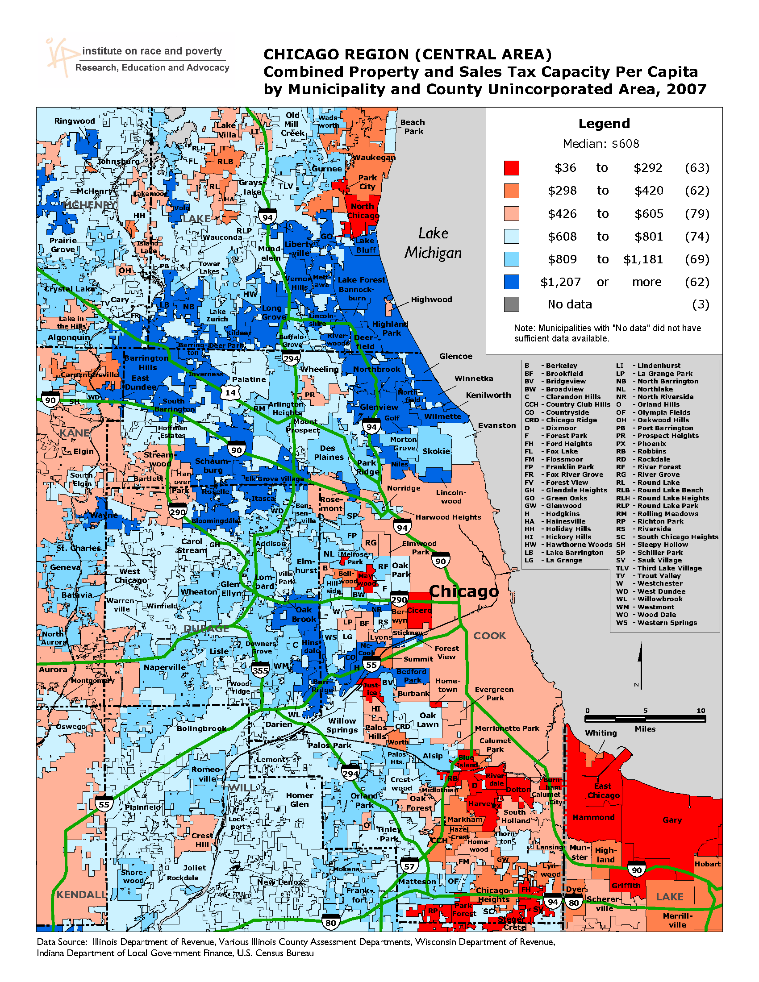

Slide 21
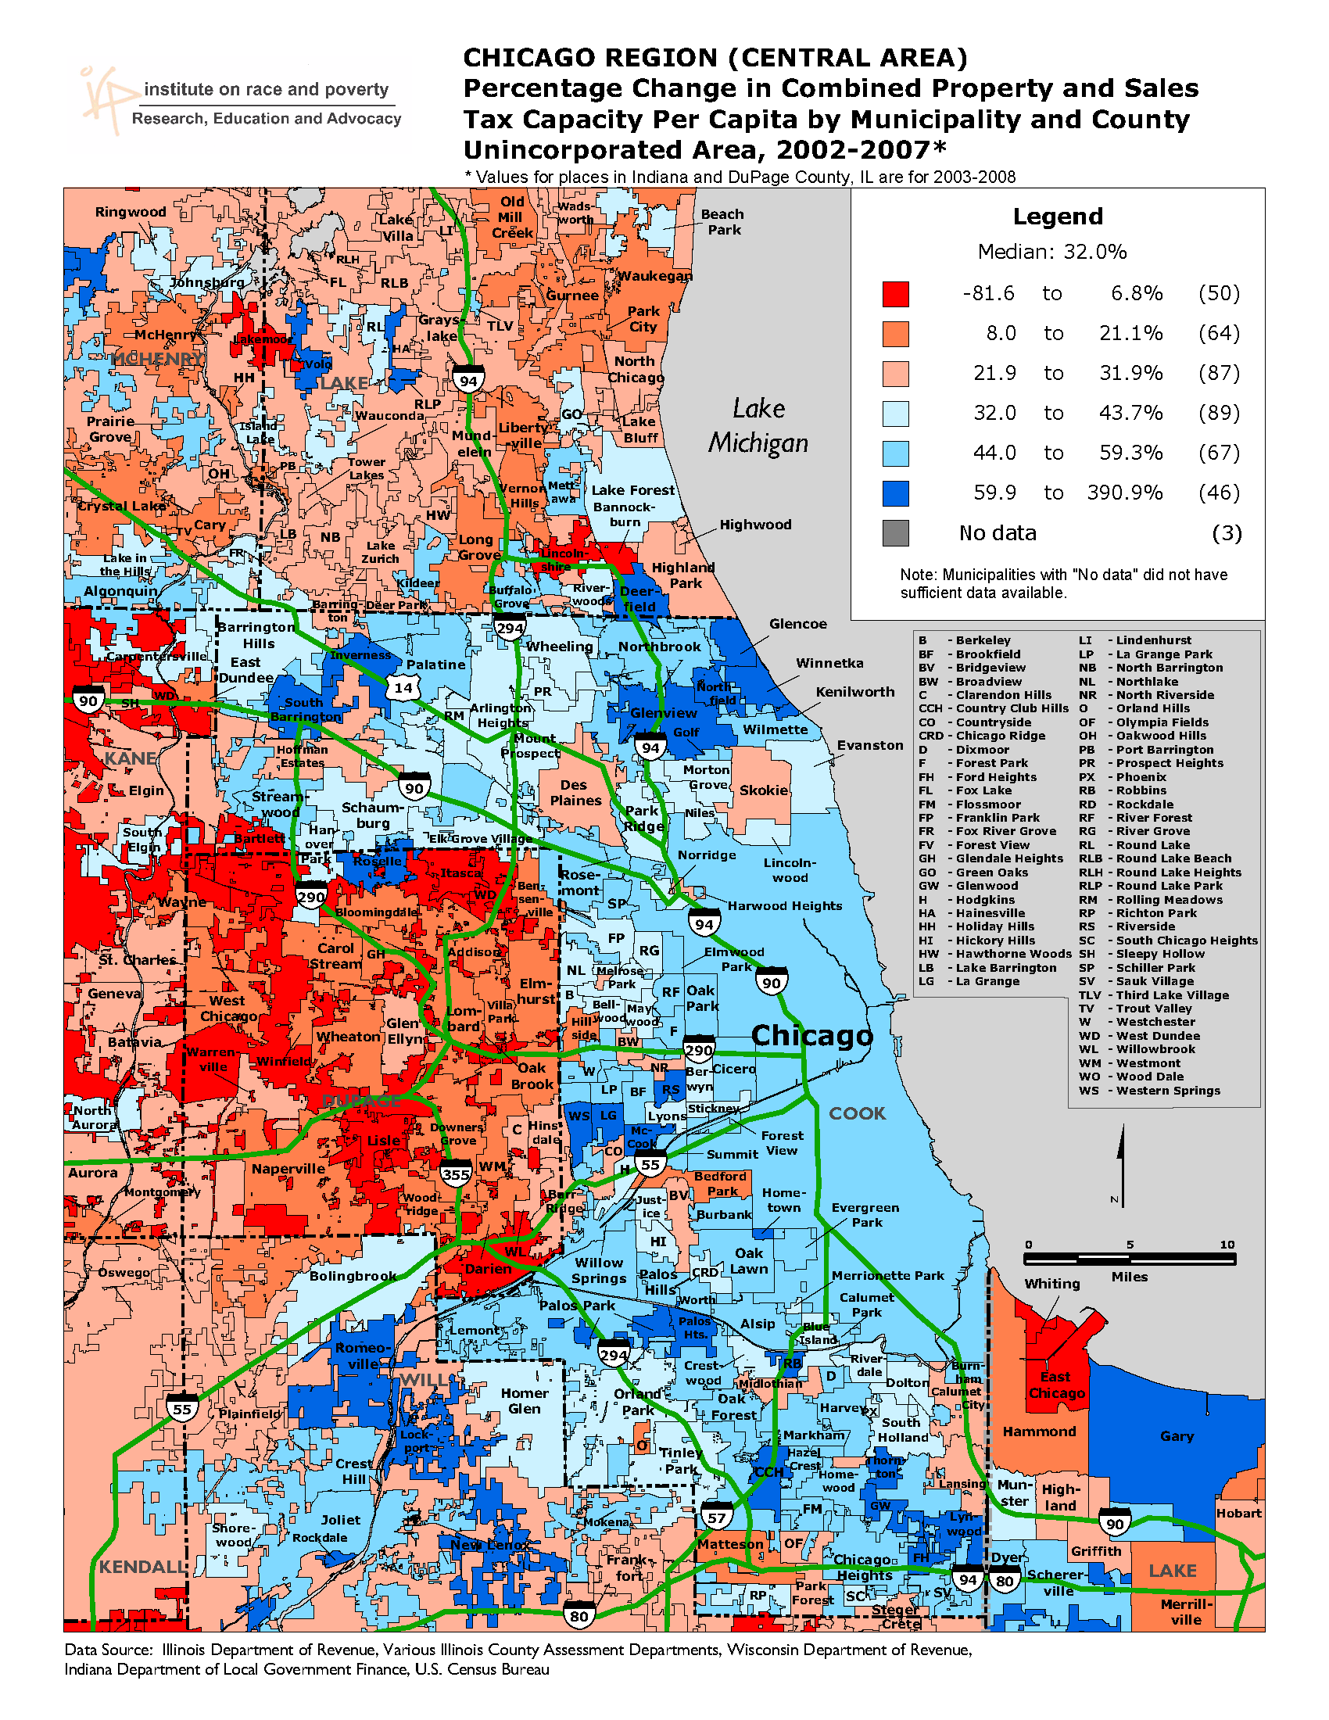

Slide 22
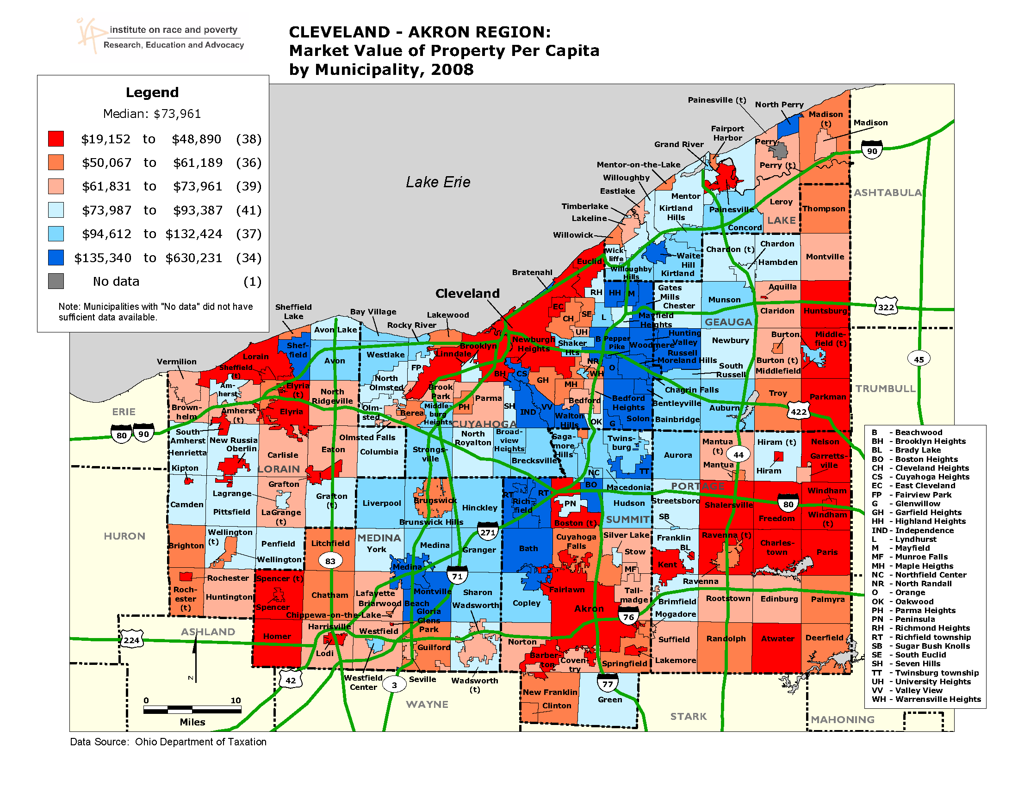

Slide 23
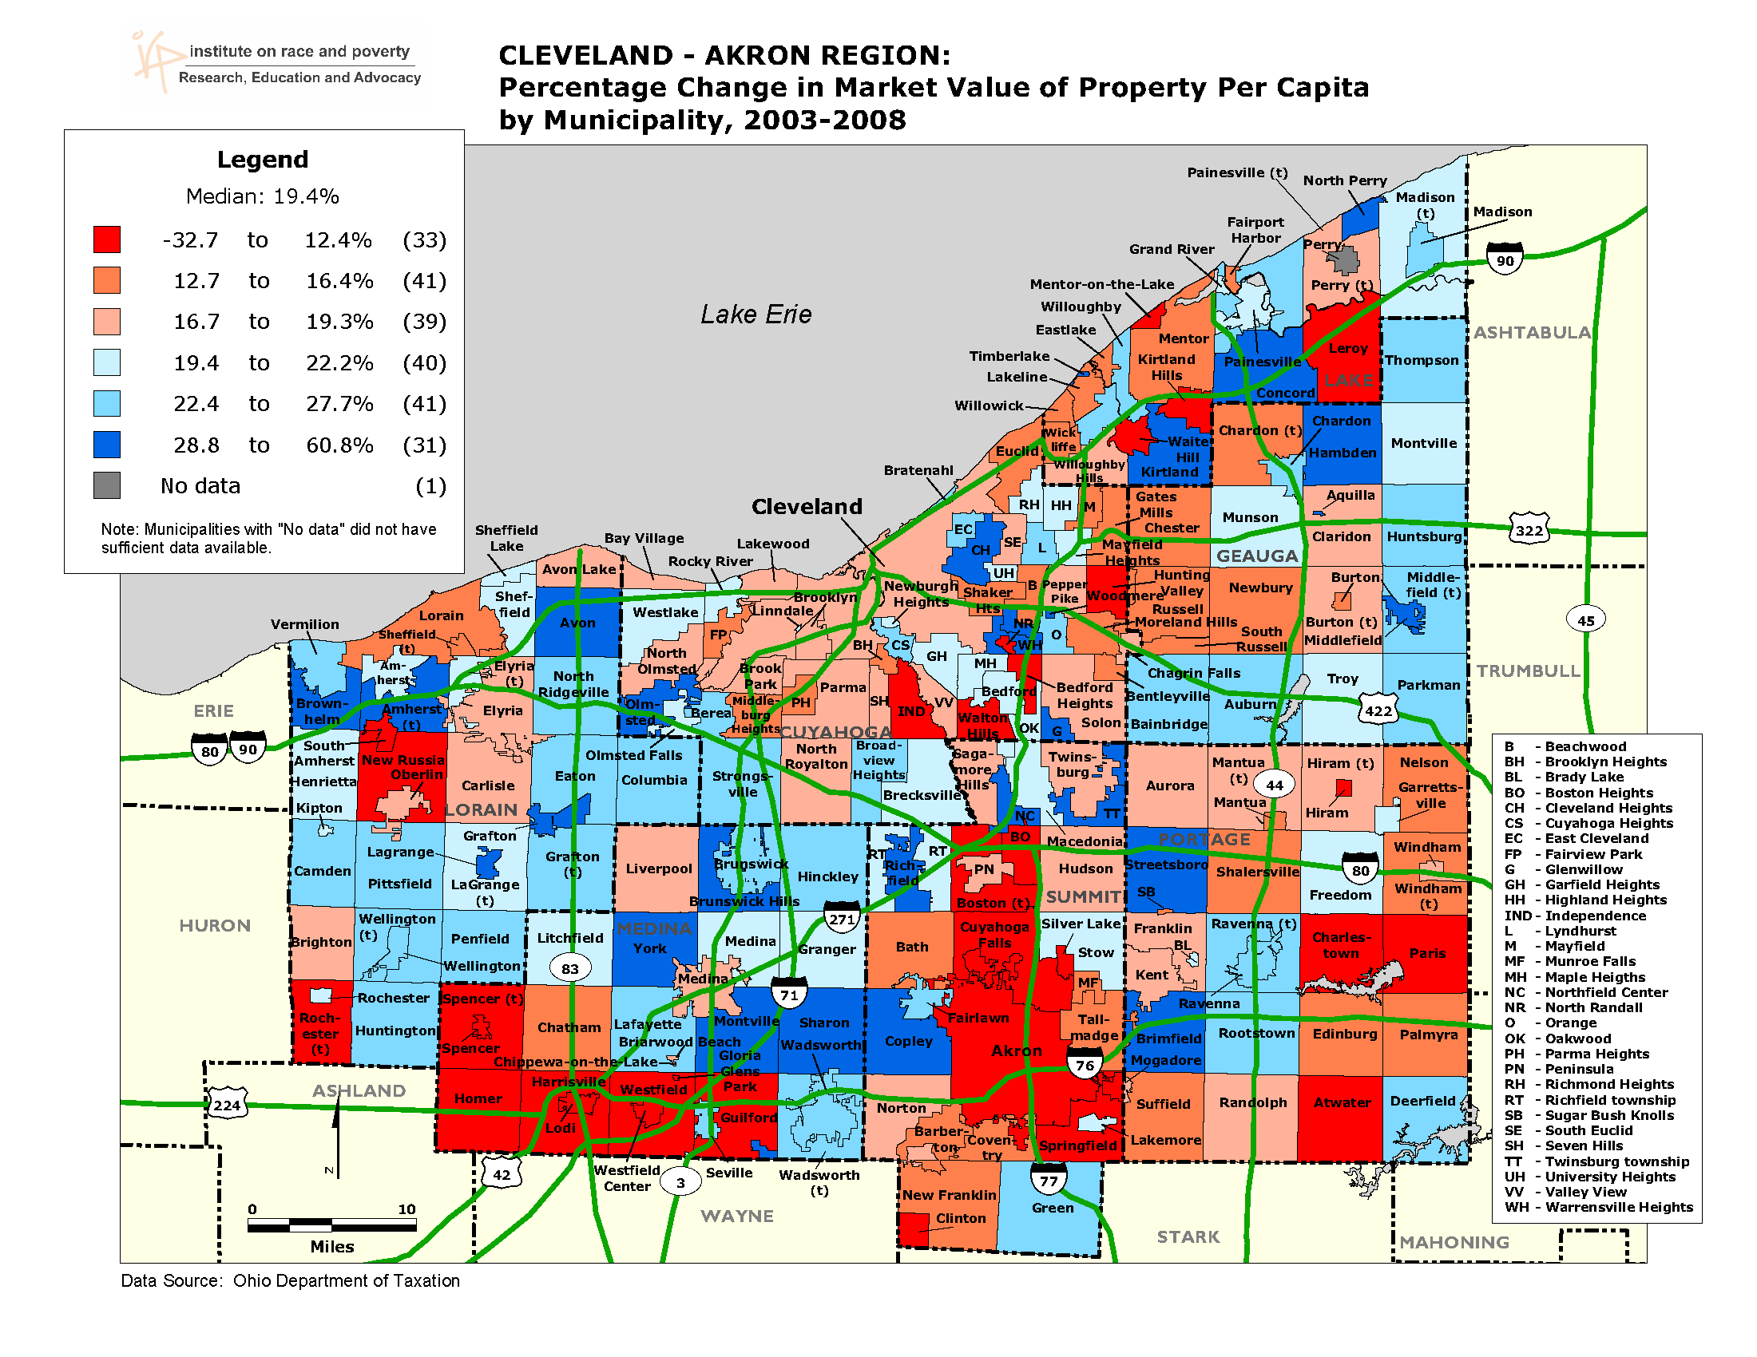

Slide 24
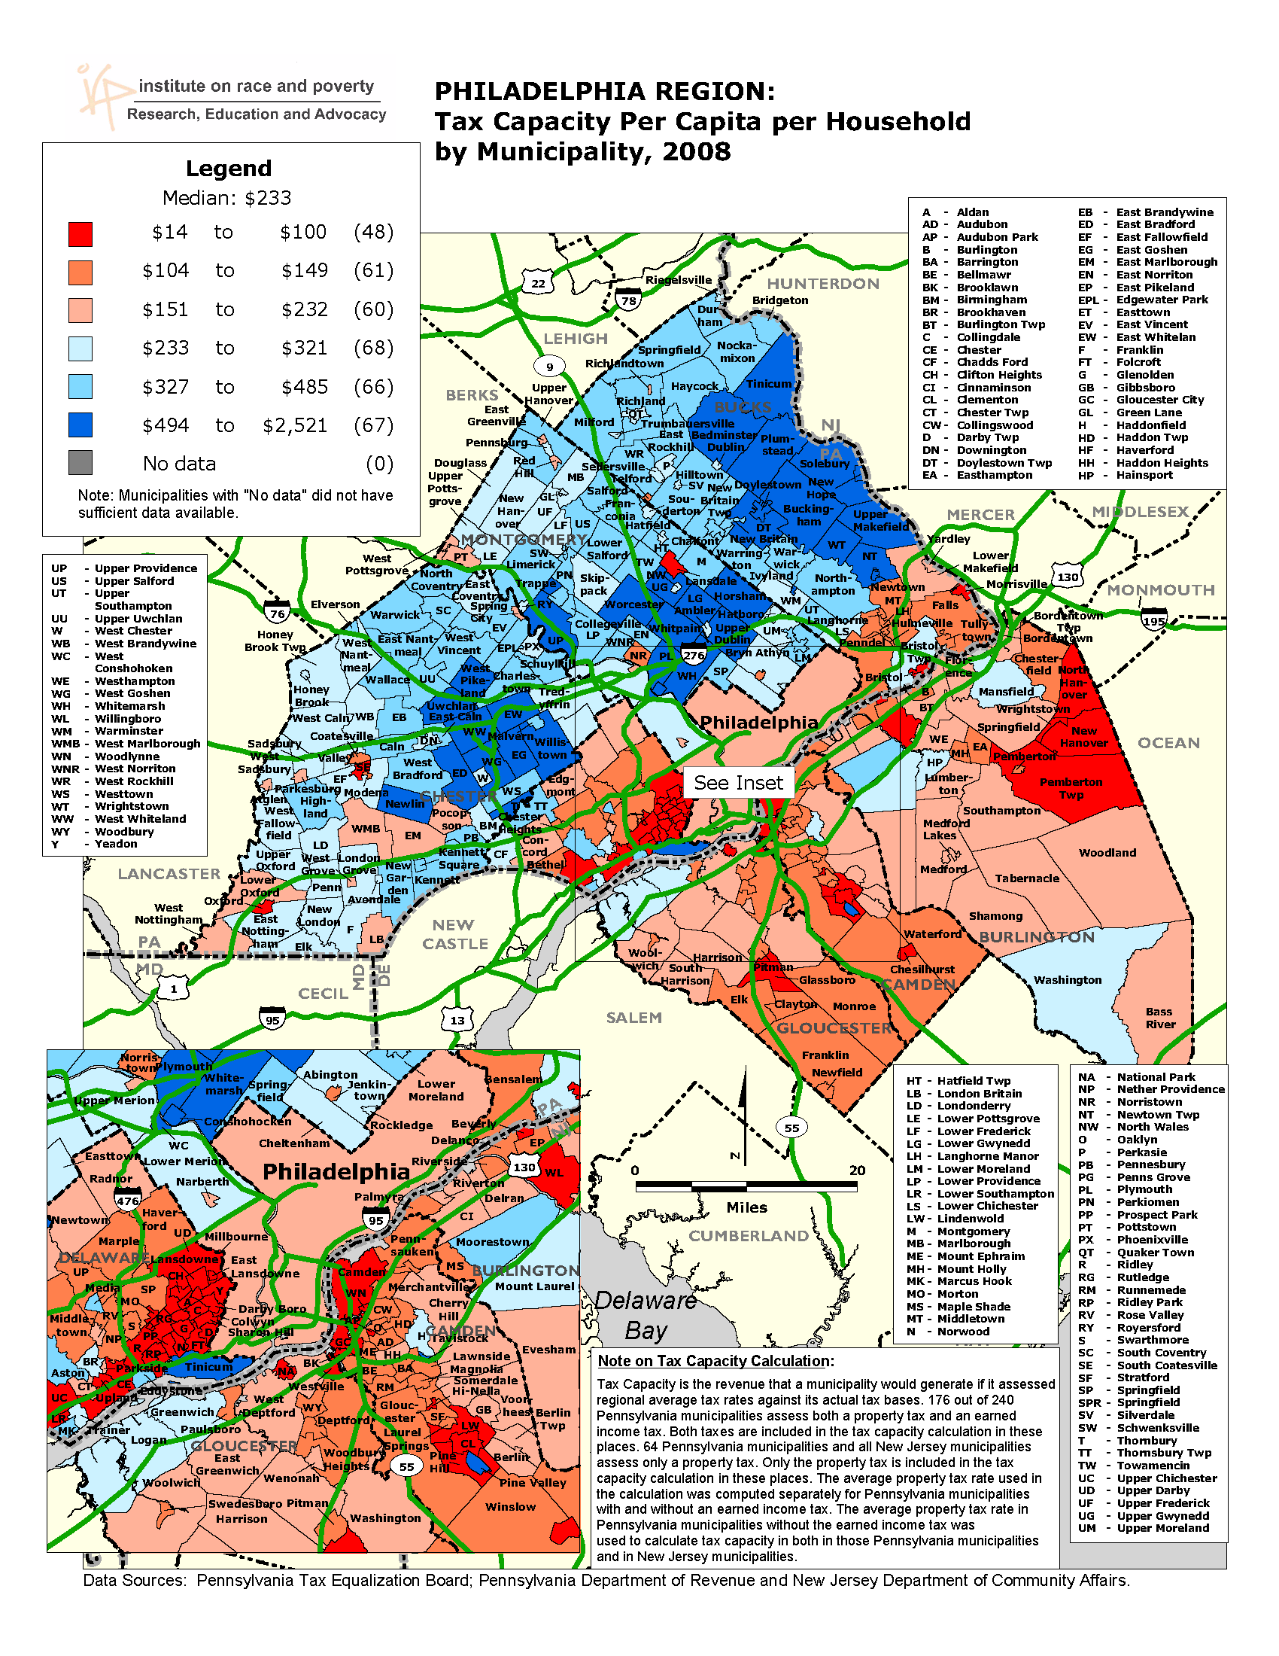

Slide 25
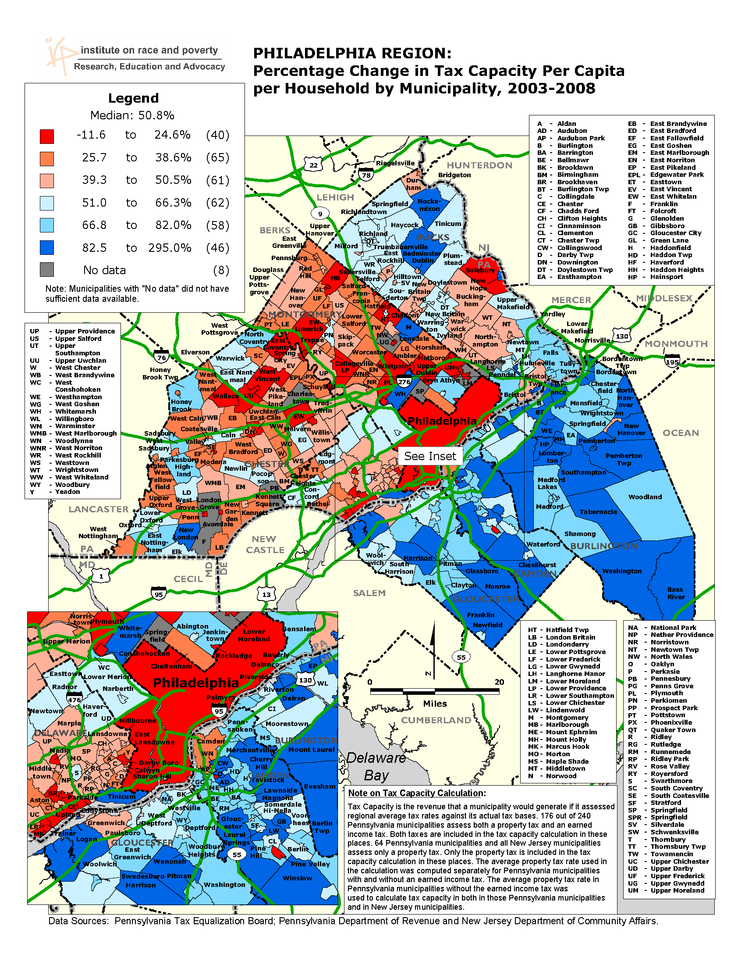

Slide 26
Segregation

Slide 27
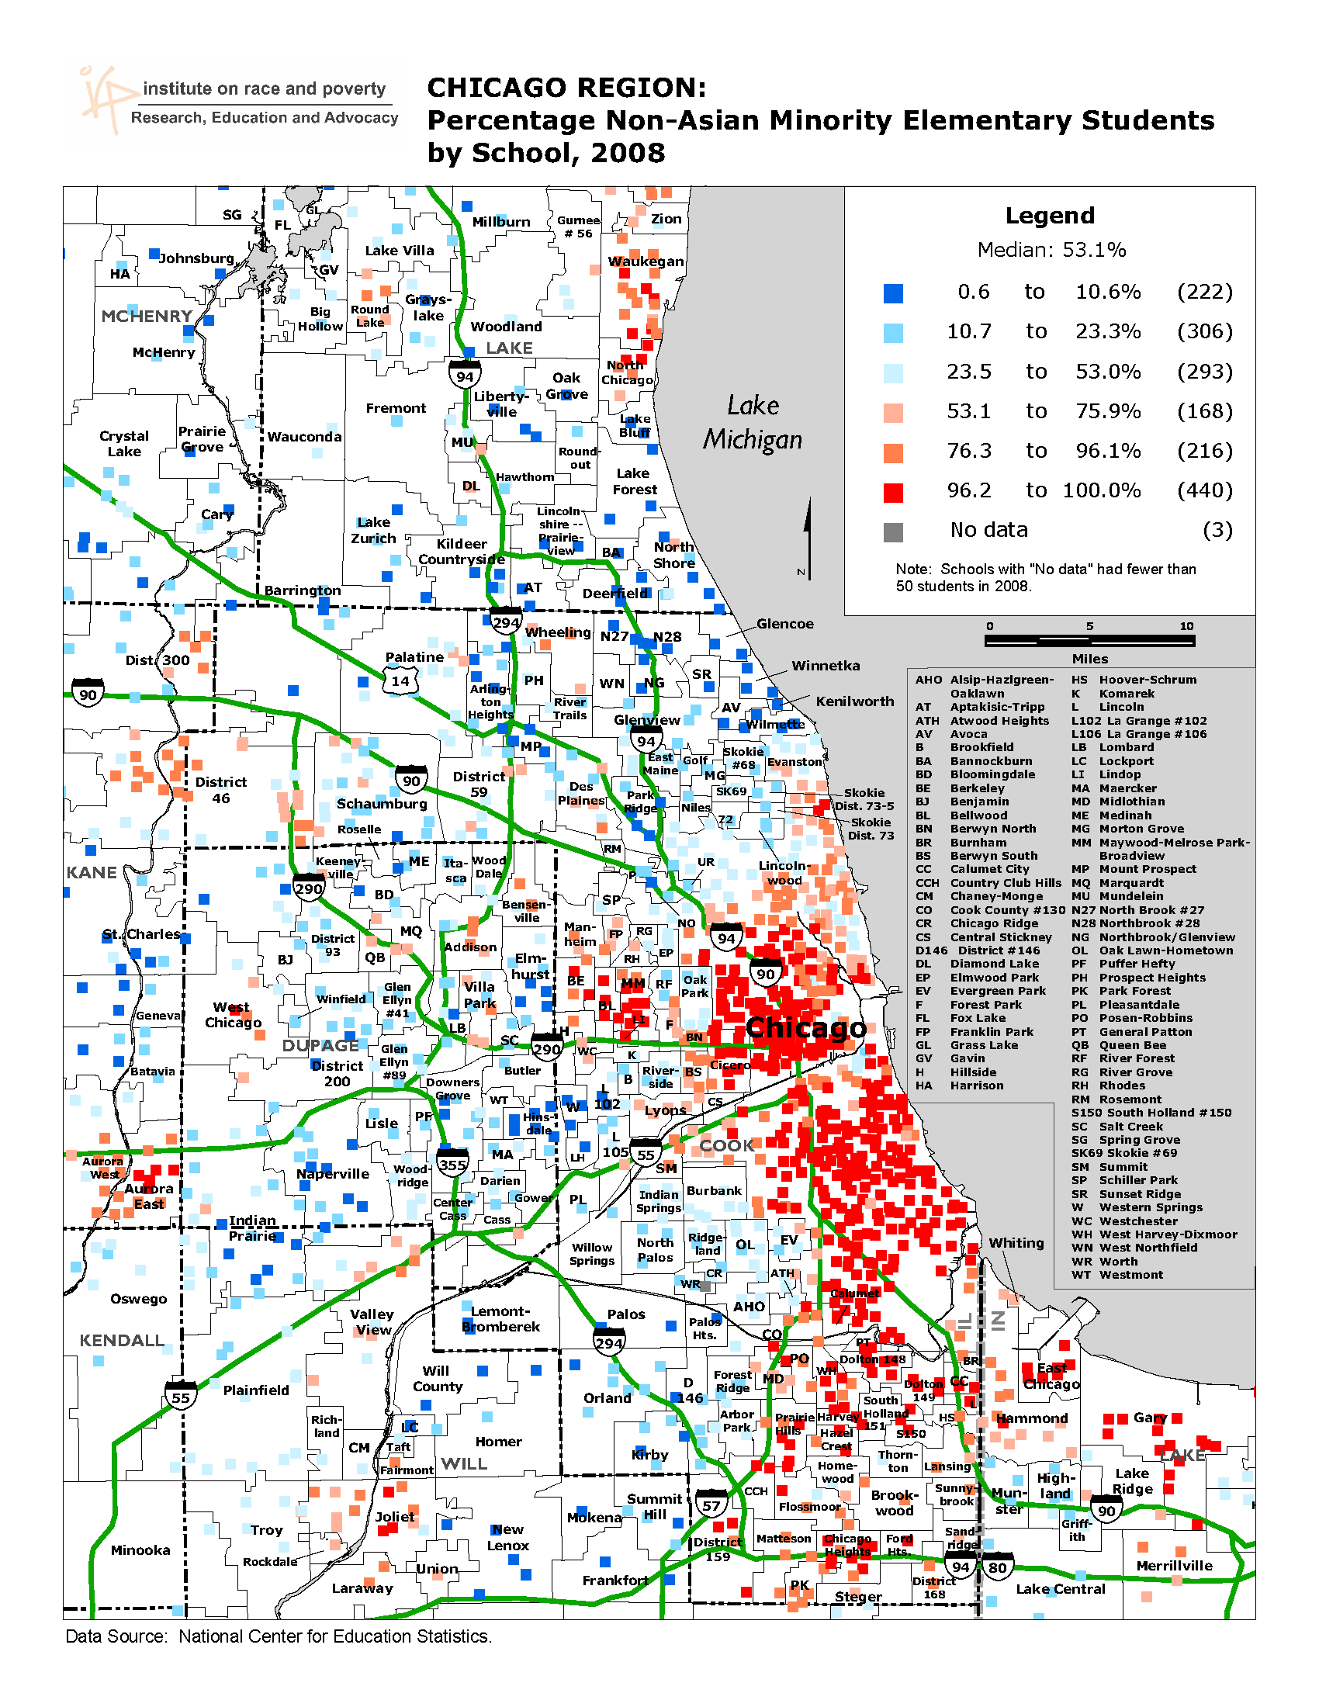

Slide 28
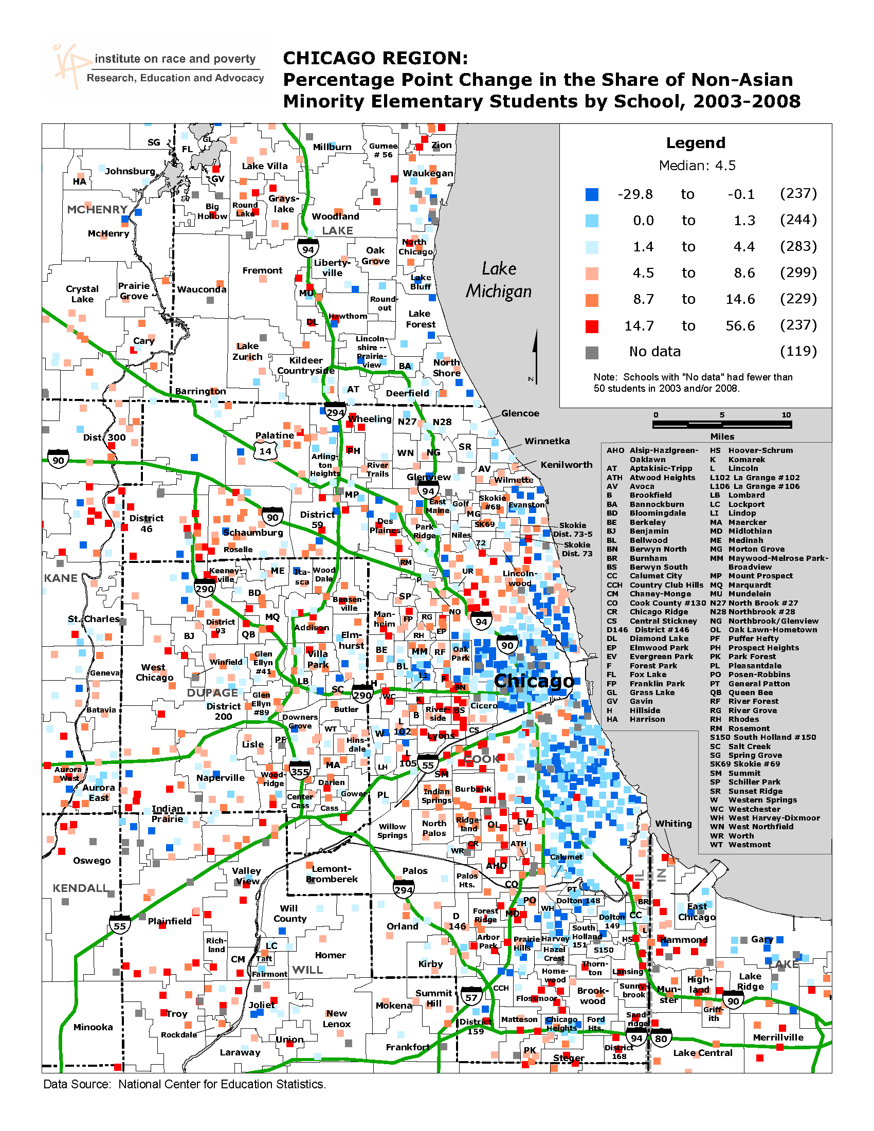

Slide 29
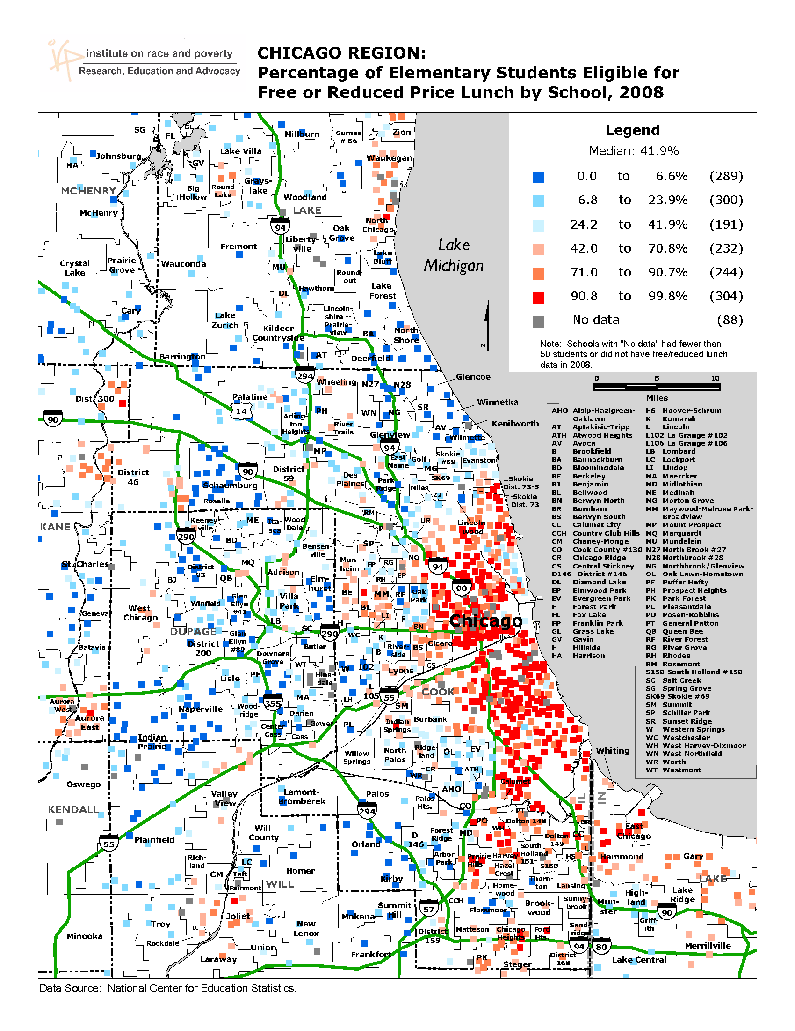

Slide 30
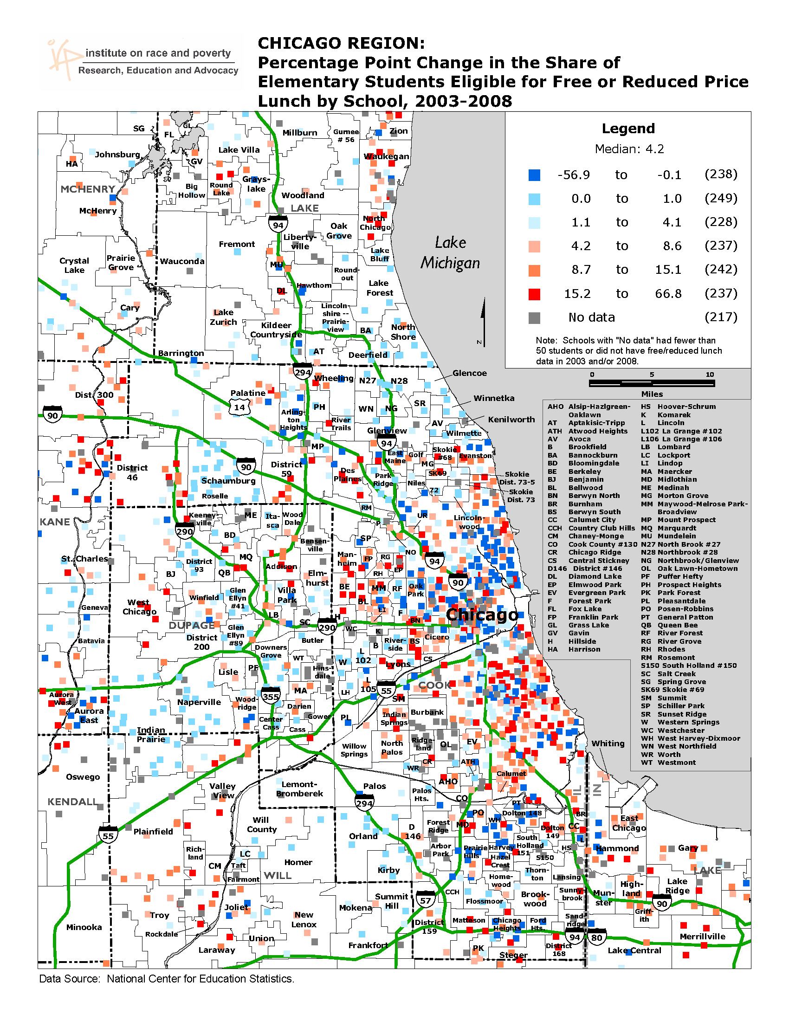

Slide 31
Distribution of Population in the 50 Largest Metropolitan areas (2005-09) Central Cities: 31% Predominantly non-white suburbs: 10% Diverse suburbs: 30% Predominantly white suburbs: 21% Exurbs: 10% Predominantly non-white suburbs: more than 60% of residents non-white. Integrated suburbs: areas with non-white population shares between 20% and 60% Predominantly white suburbs: areas with more than 80% of population white Exurbs: areas with less than 10% of land urbanized in 2000
40%
31%

Slide 32
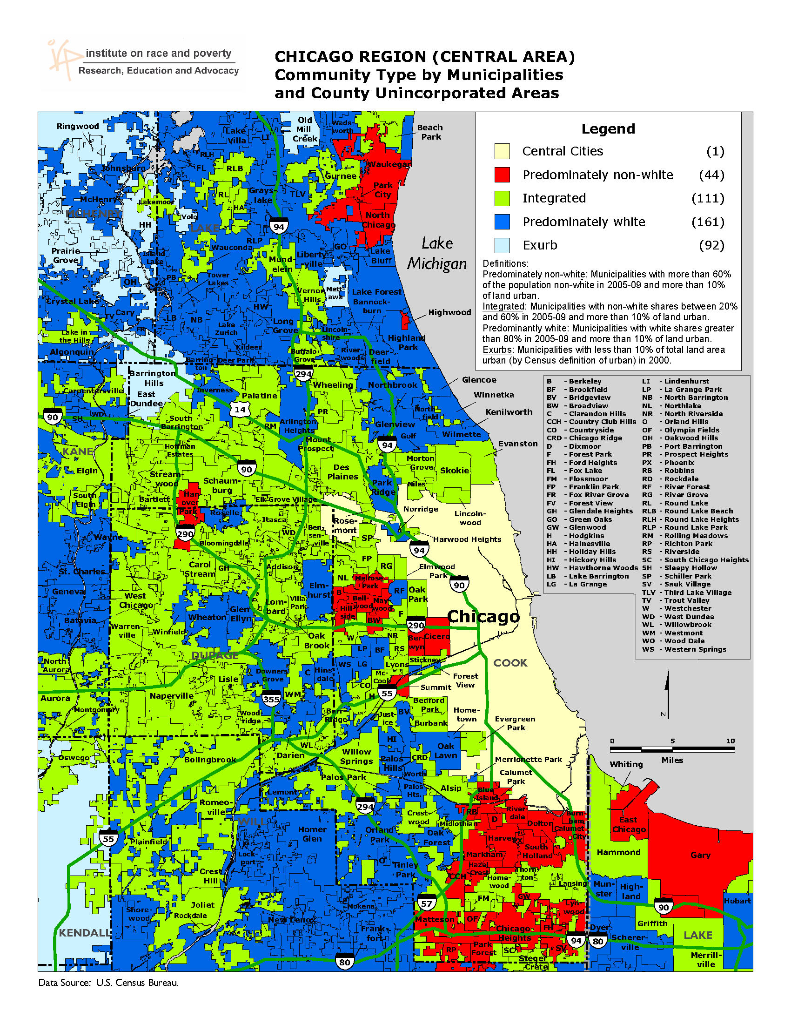
Diverse

Slide 33
Policy Solutions
Unified regional approaches to regional problems to
economic growth, sustainability and social equity
(small-scale service sharing is not enough)
Targeted Infrastructure/transportation investments
Regional fair housing initiatives that reduce segregation
and concentrated poverty in older suburbs
Fiscal equity initiatives—tax-base sharing; state aid
for schools, cities and towns that reduce reliance on
local property taxes
Get organized – build state and regional organizations of
first suburbs fully developed communities with Building
ONE America

